Slide 1
The Effects of Land Value Taxation in a Computable General Equilibrium Model
A David C. Lincoln Fellowship in Land Value Taxation
Alex Anas
University at Buffalo – SUNY
October 31, 2014

Slide 2
Purpose of project (Year One)
To study the effects of land value taxation in a spatially detailed computable general equilibrium model, in order to see how the urban system will adjust to a shift toward land value taxation and examine how neutral and efficient such taxation is
Shift from Conventional Property Tax (CPT) to a Uniform Land Tax (ULT) on residual (land) value.
A higher Uniform Land Tax (ULT) to substitute for a lower income tax, or sales tax.

Slide 3
Why CGE models for land taxation?
The conventional literature treats simple settings:
Buildings are perfectly malleable→ adjustments are immediate
Only the real estate market is considered. Labor, production and other markets are ignored.
The presence of other taxes is ignored when studying a shift to the land tax.
The conventional literature predicts:
Perfectly neutral welfare effects of land tax increases
Shifts from low to high structural densities (lower to higher FAR)
Reductions in urban sprawl

Slide 4
The RELU-TRAN Model
A Regional Economy, Land Use and TRANsportation Model
Anas, Alex and Liu, Yu, “A regional economy, land use and transportation model (RELU-TRAN): formulation, algorithm design and testing,” accepted for publication in the Journal of Regional Science, 47(3), 415-455, 2007.
For published papers on RELU-TRAN applications see:
https://sites.google.com/site/alexanashomepage/the-relu-tran-model-and-its-applications

Slide 5
Structure of the
RELU-TRAN model
STARTING POINT
p, w, R,V,S G, g
RELU-TRAN CYCLE
RELU
RELU LOOPS CONVERGED
Update
G and g
for next
cycle
RELU TRIPS
TRAN
TRAN ITERATIONS CONVERGED
G and g converged?
p, w, R, V converged?
Excess demands, profits converged?
NO
YES
RELU-TRAN CYCLES
CONVERGED
Cyclical linking of the RELU and TRAN algorithms in RELU-TRAN

Slide 6
START POINT
p, w, R, V, S, G, g
Structure of the
RELU-TRAN model
RELU LOOP
PRICES, p
( w, R ) →p
OUTPUTS, X
( p, w, R, S,V ) →X
WAGES, w
( p, X, R,S,V )→w
Update
p, w, R, V
for next loop
RENTS, R
(p, X, w, S,V)→ R
VALUES, V
R→V
STOCKS, S
V→S
NO
p, w, R, V converged?
Excess demands converged?
Economic profits converged?
YES
RELU loops converged
The RELU algorithm

Slide 7
Structure of the
RELU-TRAN model
RELU TRIPS
AUTO MODE CHOICE
PROBABILITIES
ROUTE CHOICE & NETWORK
EQUILIBRIUM FLOW
ITERATIONS CONVERGED
CONGESTED HIGHWAY LINK
TRAVEL TIMES
ZONE-TO-ZONE
EXPECTED TIMES & COSTS
G and g
TRAN
The TRAN Algorithm

Slide 8
Consumer choice in RELU-TRAN
Structure of the Model

Slide 9
Dimensions of the L.A. RELU-TRAN model
The L.A. model covers six counties (LA, Orange, Ventura, Riverside, San Bernardino and Imperial). These are divide into 97 zones
Income quartiles are treated
There are 2 housing types (SF, MF) and commercial, industrial and public buildings and vacant land
Nine industries are included and their interactions are modeled

Slide 10
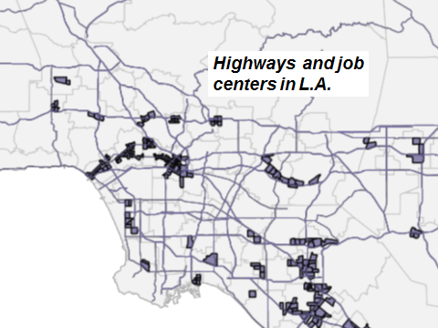

Slide 11
Dimensions of the Paris RELU-TRAN model
The Paris model covers the Greater Paris region which is divided into 54 zones
There are 2 housing types (SF, MF) and commercial, industrial and public buildings and vacant land
Private sector and public sector employment are treated in the model

Slide 12
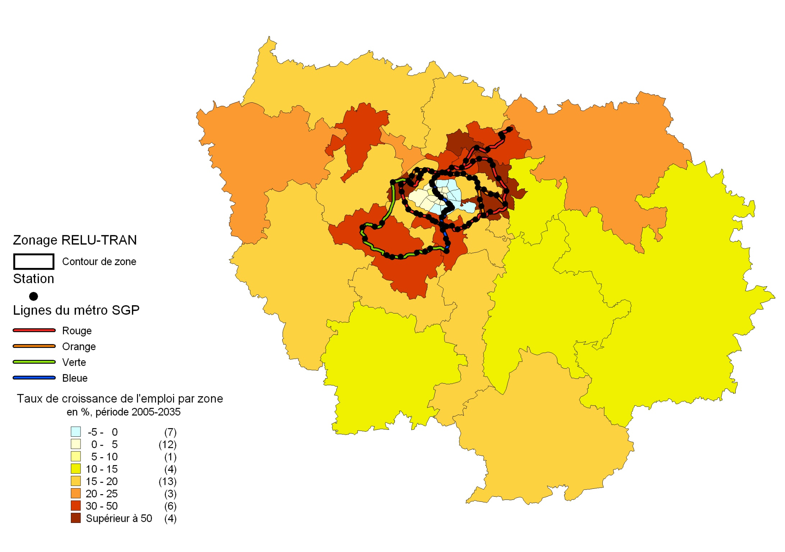
Public transit
and job centers in Paris

Slide 13
http://www.youtube.com/watch?v=8gusipxlliU
Presentation on YouTube:
Slideshare:
http://www.slideshare.net/NewEconomicSchool/what-do-chicago-paris-and-los-angeles-have-in-common
 | Public transit share in commuting | Employment dispersion
Chicago, MSA | 13% | About 30% of jobs in the 4 largest job centers
Ile-de-France (Greater Paris) | 50% | About 50% of jobs in the City of Paris and 10 surrounding suburban centers
Los Angeles, MSA | 2% | About 30% of jobs in the 30 largest job centers
RELU – TRAN
Versions

Slide 14
Definitions
PROPERTY VALUE: The total market asset value of the building and its land plot (or lot).
STRUCTURE VALUE: The cost of constructing the structure on the lot
LAND VALUE: The value imputed to the lot under the building

Slide 15
How to impute the land value?
METHOD 1 (imputation from vacant land): The model produces the market equilibrium price of the land in each zone that is vacant.
This can be imputed to all built plots in the same zone, but usually the vacant land in a zone is not randomly distributed and the imputation to built lots may not be valid. We do not use this method.
METHOD 2 (residual method): A better method is to subtract construction cost from the property’s total asset price and attribute the difference to the land. We use this method.

Slide 16
Conventional Property Tax
TAXATION OF PROPERTY IN RELU-TRAN
Uniform Land Tax (Residual Method)
Note that the ULT is an ad-valorem tax on land value (measured as residual value).
It is therefore easy to implement but not perfectly neutral

Slide 17
Other taxes in RELU-TRAN
Income tax (including Federal and State): varies by county and income quartile It is estimated as the total taxes received divided by the total income.
Sales tax: varies by county. We use the known rates.
Producer-wage to worker-wage markup: included here is FICA and Medic. taxes and non-wage compensation which we are unable to separate.

Slide 18
Welfare measurement
Social welfare (= benefit of a tax change) is measured by adding up
the following:
Consumer surplus change per year
Tax revenue change per year
Change in aggregate property values (annualized)
(In the model, producers make zero excess profits, hence there is no producer’s surplus.)

Slide 19
Textbook diagram explaining
welfare measurement method
$/sq.ft
CS
Supply
TR
DWL
Demand
VC
Sq. ft
WELFARE = CS + TR + VC

Slide 20
Distribution of population, jobs,
vacant land and floor space
in Greater L.A.

Slide 21
Revenue neutral switch from the CPT to the ULT (year 2000)
COUNTY | Imperial | LA | Orange | Riverside | San Bernardino | Ventura
CPT (Data) | 0.810% | 0.655% | 0.612% | 0.936% | 0.735% | 0.671%
ULT (RELU) | 1.161% | 1.161% | 1.161% | 1.161% | 1.161% | 1.161%
Under the CPT, 14.1% of the total property tax revenue is from vacant land, 45.6% is from occupied land and the remaining 40.3% is from building structures.

Slide 22
Welfare effects of increasing the ULT
 | Per person annual $ change
Uniform Land Tax Rate (% of Land Value) | Consumer Surplus | + | Buildings Value Change | + | Tax Change | = | Total Welfare Change
1.66 | -7 |  | +9.2 |  | +7.2 |  | +9.4 | ULT replaces CPT (revenue neutral)
2.31 | -56 |  | -872 |  | +2545 |  | +1617
3.31 | -95 |  | -1451 |  | +3854 |  | +2308
4.31 | -128 |  | -1918 |  | +5049 |  | +3003
5.31 | -156 |  | -2303 |  | +6160 |  | +3701
6.31 | -180 |  | -2625 |  | +7207 |  | +4402
7.31 | -201 |  | -2899 |  | +8205 |  | +5104
8.31 | -219 |  | -3135 |  | +9164 |  | +5808
9.31 | -236 |  | -3340 |  | +10091 |  | +6513

Slide 23
Other effects of the ULT
Increasing the ULT from 1.3% to 4.3%, buildings of higher (residual) land value become more costly relative to buildings of lower land value.
Houses have lower construction cost higher land value, hence house stock shrinks by 3.3%. This causes house rents to increase.
Apartment building stocks increase by 1.5%. Rents fall.
Commercial building stocks increase by 1%. Commercial rents fall.
Summary: higher ULT makes houses too costly therefore some houses are demolished and higher density buildings are built instead.

Slide 24
Other effects of the ULT – continued 1
Lower commercial rents induce a real output increase by 0.13%. The higher output needs more labor hence wages increase by 0.3%.
The reallocation of population and jobs is small. Population in LA County drops by 20,632 due to the higher rents of houses, and in Orange County population grows by 16,890 because the rent increases of houses in Orange are smaller.
Higher wages dominate lower commercial rents, leading to a higher production cost and higher prices for goods and services by 0.2%. With greater real output, aggregate sales also increase.
Since most people live in houses, the rent increase of houses, together with the higher prices for goods and services, dominate the increase of wages therefore consumer surplus suffers falling by$ 128 per year per person.

Slide 25
Other effects of the ULT – continued 2
Property values decrease by $1,918/person/year because of the higher ULT rate.
Income tax and wage taxes increase because wages are higher.
The sales tax is higher since, given the sales tax rate, tax base is now bigger.
The property tax also increases because the ULT rate increased.
Overall welfare per person improves by $3003.

Slide 26
Substitution of land tax for the income tax
Per person annual $ change
Consumer Surplus | + | BuildingValue Change | + | Tax Changes | = | Total Welfare Change | A Uniform land tax increase from 1.1% to 4.1% replaces revenue loss from a 10% decrease in the income tax for all quartiles. Income tax plus property tax revenue is unchanged.
+234 |  | -1652 |  | +1768 |  | +351
 |  |  |  | +1935 | Property tax change
 |  |  |  | -268 | Income tax change
 |  |  |  | +101 | Sales tax change
 |  |  |  | 0 | Wage tax change

Slide 27
Other effects of the substitution of the ULT for the income tax
The consumer surplus of the employed improves because the lower income tax raises disposable income and consumer demand for goods and services. This in turn drives up labor demand and hence wages go up too.
The consumer surplus of the unemployed decreases because of higher house rents.
House rents increase because the ULT rate rises to 4.1% (from 1.1%). This leads to a 2.6% decrease in house stocks and a 1.5% increase in multifamily.
Overall, consumer surplus improves by $234 per person because the higher consumption and wages dominate the increase in housing costs.

Slide 28
Other effects of the substitution of the ULT for the income tax -- continued
Building values per person decrease by $1,652 because of the higher ULT.
Tax revenue from all sources increase by $1,768 per person.
The property tax increases because of the higher ULT, the sales tax increases because of higher price of goods and services and the higher demand, while the income tax revenue drops due to the lower income tax rate.
Higher wages, and higher commercial rents caused by increased consumer demand push up production cost and therefore prices are higher by 1%. Real output, driven by demand, is also greater than before by 0.6%, despite the higher production cost.
GDP increases by 1.6%.

Slide 29
Substitution of land tax for the sales tax
Per person annual $ change
Consumer Surplus | + | BuildingValue Change | + | Tax Changes | = | Total Welfare Change | A uniform land tax increase from 1.1% to 1.9% replaces revenue loss from a 10% decrease in the sales tax revenue. Sales tax plus property tax revenue is unchanged.
+59 |  | -617 |  | +5.13 |  | -553
 |  |  |  | +627 | Property tax change
 |  |  |  | +7 | Income tax change
 |  |  |  | -629 | Sales tax change
 |  |  |  | 0.15 | Wage tax change

Slide 30
Other effects of the substitution of the ULT for the sales tax
The sales tax revenue drops by $ 630 per person because of the lower sales tax rate. This is due to the inelasticity of the demand for most goods and services.
The sales tax base (or aggregate output value) increases by a small amount, because:
1) Although wages increase, commercial rents decrease due to more commercial buildings as a result of the higher ULT rate. These opposite wage and rent changes cancel the effect on price, leading to small increases in after-tax price.
2) Since the after-tax price increase is small real output change is also small.

Slide 31
Conclusions
We saw that the ULT (uniform ad-valorem tax on residual lot values) has positive overall welfare effects when it is substituted for the conventional property tax or for the income tax.
It has a negative overall welfare effect when it is substituted for the sales tax.
The ULT does induce a shift from low density SF houses to higher density apartment and commercial buildings.

Slide 32
Conclusions -- continued
In the simulations done so far, the ULT had small effects on traffic congestion.
In the simulations done so far, the ULT had spatially varying effects increasing jobs, population and urban sprawl in some outlying areas while decreasing it in others.

